Slide 1

School of Computing Science and Engineering
Course Code: E2UC304C Course Name: Java & JavaScript
Section: 26(P1)
Project Title:
" Banking Management System "
Submitted To:
Dr. Sonia Saini
Team Member:
Aditya Rai (22SCSE1012774)
Govind Kumar (22SCSE1012853)
Utkarsh Kumar (22SCSE1012806)

Slide 2

Presentation Outline
Presentation Outline are:
Acknowledgement
Introduction
Aim of Project
Requirements of Project
Project Modules
Flow Chart
Output Screenshot
References

Slide 3
Acknowledgement
We would like to take this opportunity to express our profound sense of gratitude and respect to all those who helped us throughout the duration of this project. Galgotias University in particular has been the source of inspiration for us. We acknowledge the effort of those who have contributed significantly to our project. We feel privileged to offer my sincere thanks and deep sense of gratitude to supervision of Dr. Sonia Saini as project guide, for expressing his confidence in us by letting us work on a project of this magnitude and using the latest technologies and providing his support. help & encouragement in implementing this Project.

Slide 4
Introduction
A Bank Management System is a software application that helps banks and other financial institutions manage their daily operations. It provides a centralized platform for managing customer accounts, transactions, loans, and other banking services. The system is designed to be user-friendly and secure, with features such as multi-factor authentication, encryption, and access control.
There are many different types of bank management systems available, ranging from simple desktop applications to complex enterprise-level systems. Some of the key features of a bank management system include:
Account Management: This feature allows bank employees to manage customer accounts, including opening new accounts, closing accounts, and updating account information.
Transaction Management: This feature enables bank employees to process transactions, such as deposits, withdrawals, and transfers.
Reporting: This feature provides bank employees with access to a wide range of reports and analytics, such as customer account balances, transaction histories and mini statements

Slide 5



Aim & Requirements of Project
Aim of The Project:
The principle objective of planning and developing this monetary framework is to give steady and productive net monetary workplaces to monetary customers through the web. This bank application permits all monetary customers to sign in utilizing their record login id and mystery word on the got list. Customers would approach all alternatives and highlights around there, including the capacity to get cash from a western affiliation., send money or cash to bury banking just like other financial clients by basically adding them as payees, and send money or cash to bury banking just like other financial clients by essentially adding them as payees
Requirements of Project :
Java
APACHE NetBeans IDK 20
MySQL

Slide 6
Project Modules
1. Admin Module : Administrator can get to this venture there is an approval cycle. On the off chance that you login as an Administrator, at that point you will be diverted to the Administrator Landing page and on the off chance that you are a basic client you will be diverted to your Record Landing page. This plays out the accompanying capacities: Make Singular Records, Oversee existing records, View all exchanges, Equilibrium enquiry, Erase/close record and so forth
• login • Add/update account • Withdrawal/deposit • Account Information • User information list
Mini Statement • Balance Enquiry
2. User Login: A straightforward client can get to their record and can store/pull out cash from their record. Client can likewise move cash from their record to some other financial balance. Client can see their exchange report and equilibrium enquiry as well.
• User login, use M-PIN system • open new account registration • account details
3. Registration: First you have register for this. In enrollment you have enter account number , secret phrase and Versatile Number. After this your enlistment will be effective.

Slide 7
Project Modules
4. Login Page: Here you need to enter you have enter your subtleties, for example, account number and M-PIN for login.
5. Home: At the point when you arrive at Landing page you can discover different choices, for example, ADD Record, Exchange, SHOW Users, SHOW ALL Exchange. Here you can tap on previously mentioned choice to do the activity.
6. Add Account: In add account segment you need to initially fill different fields, for example, Record NO., Record HOLDER NAME, BANK NAME, IFSC CODE, Equilibrium . At that point you can add account here.
7. Transaction: In transaction you can add the deposit and withdrawal amount. So that you don’t have to remember it.
8. Show User: Here you can see the different clients who have enlisted on this application on that specific mobile phone.
9. Show Mini Statement: You can see all your details.

Slide 8
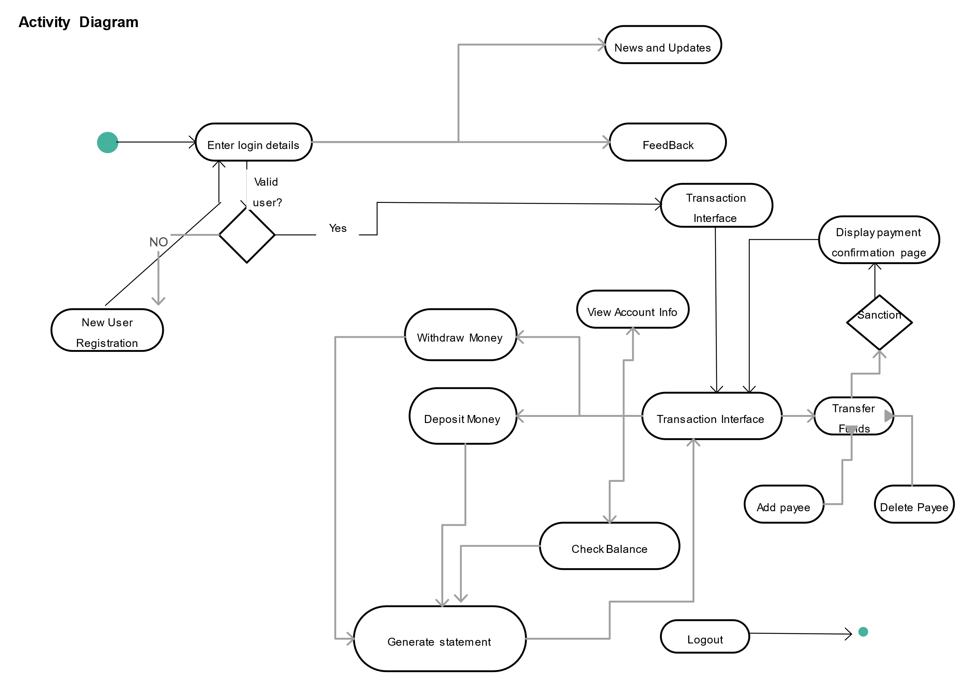
Flow Chart
Valid User?
Mini statement

Slide 9
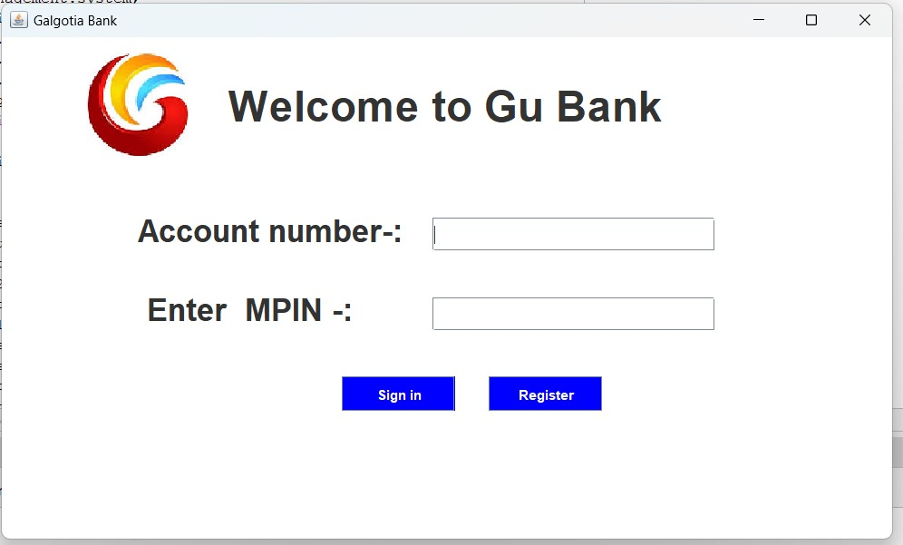
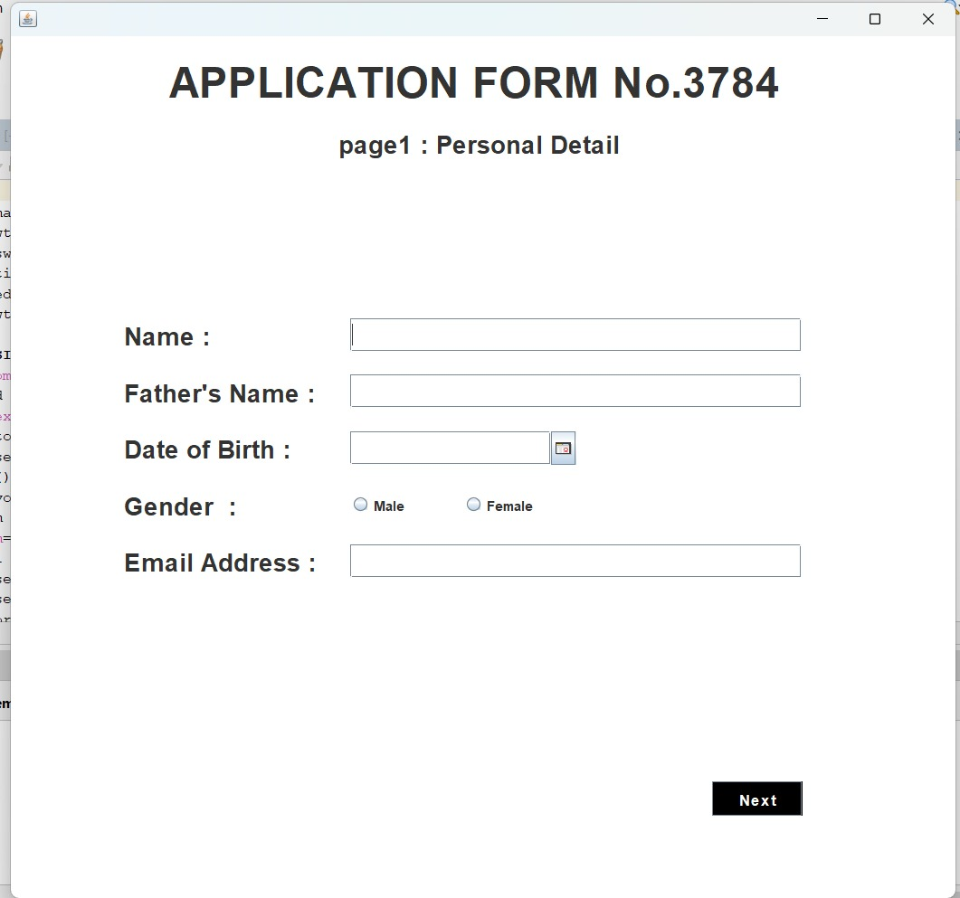
Output Screenshot
Login Page:
Login Page:
Fill Application From:
If you have a Account No. and MPIN,
Go with “Sign” In option.
For new user , Click “Register”
Click Register and Fill application from

Slide 10
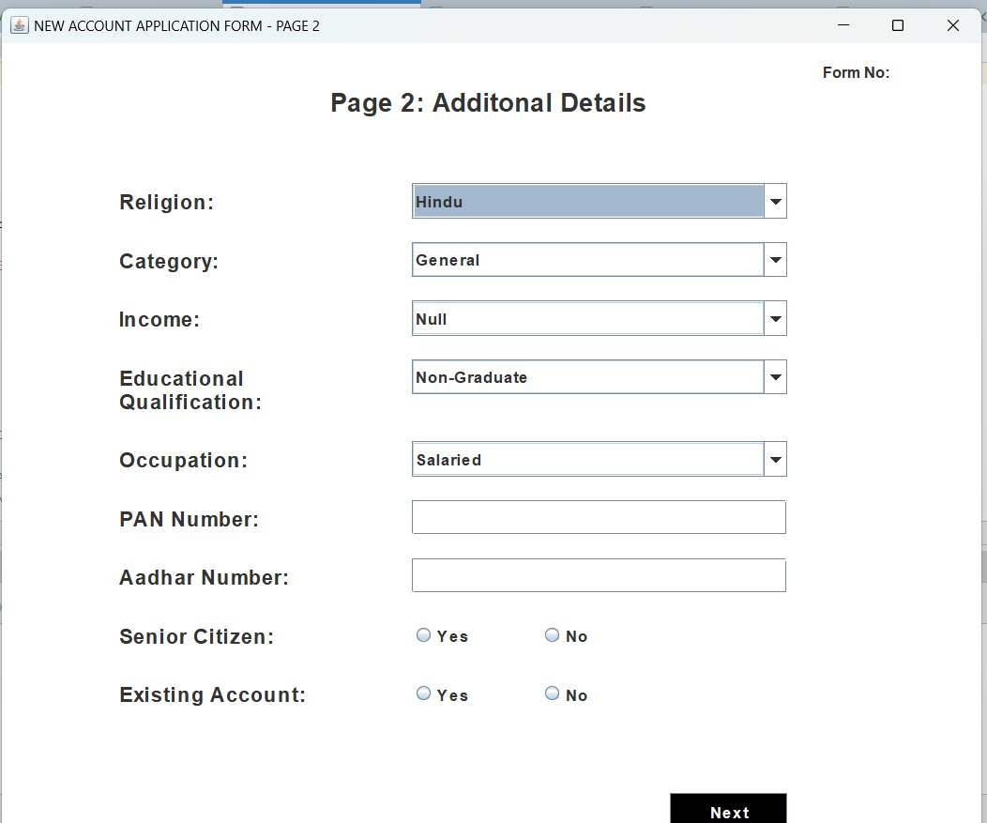
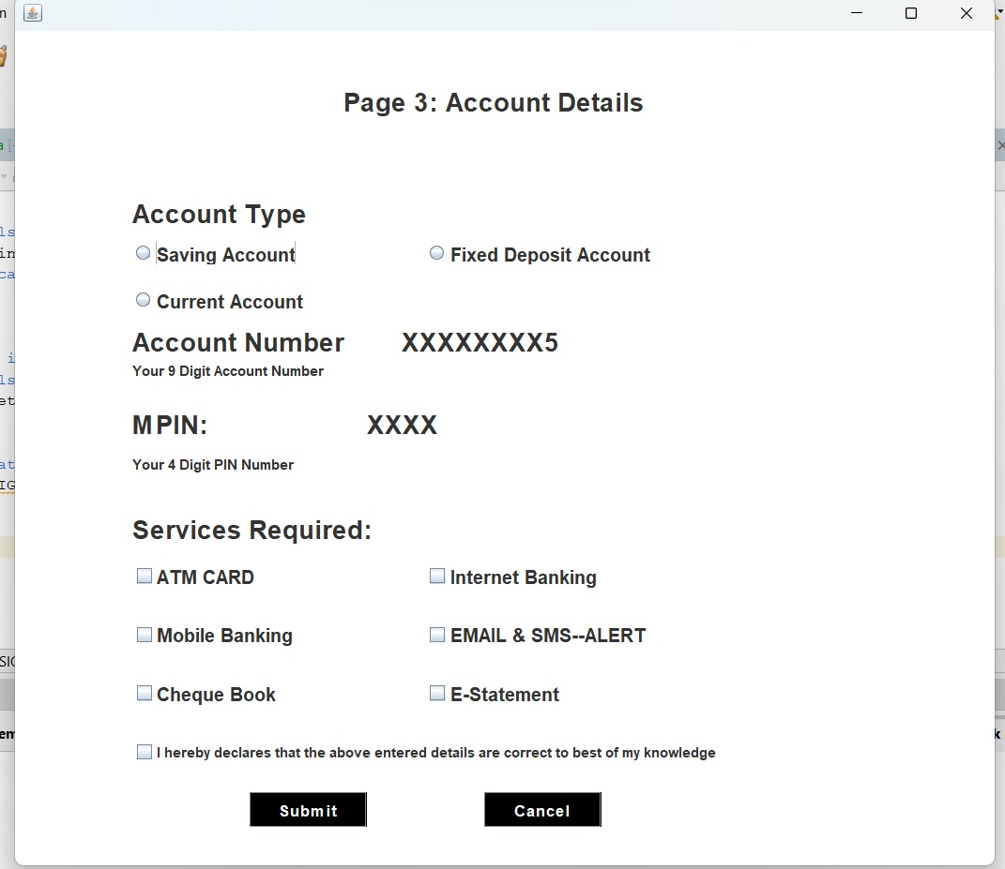
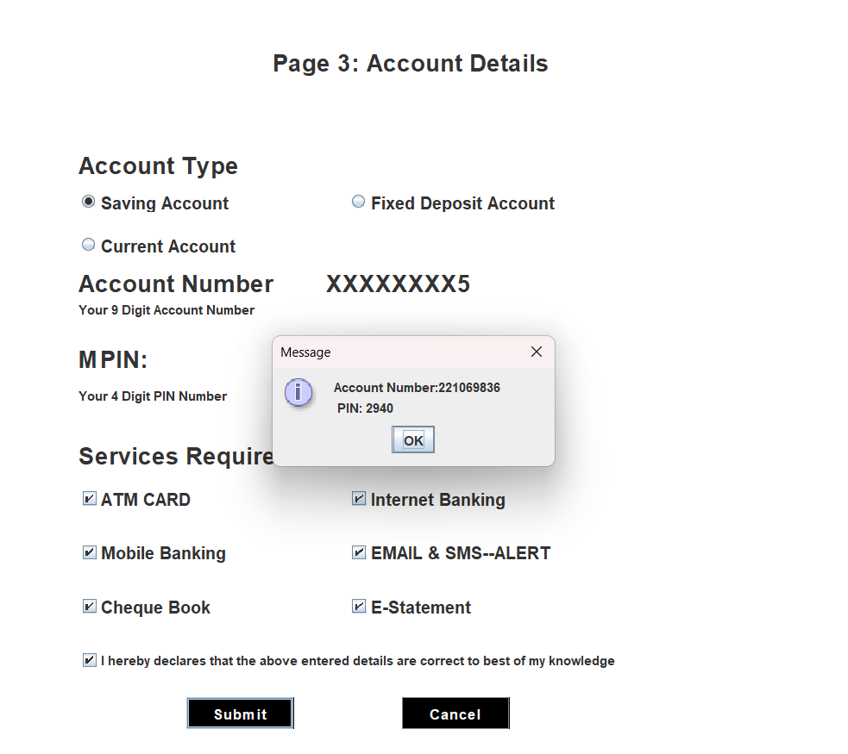
Output Screenshot
Fill Additional Details:
Fill Account Details:
After Registration
Click Next
Click Submit
Your Account No. & PIN

Slide 11
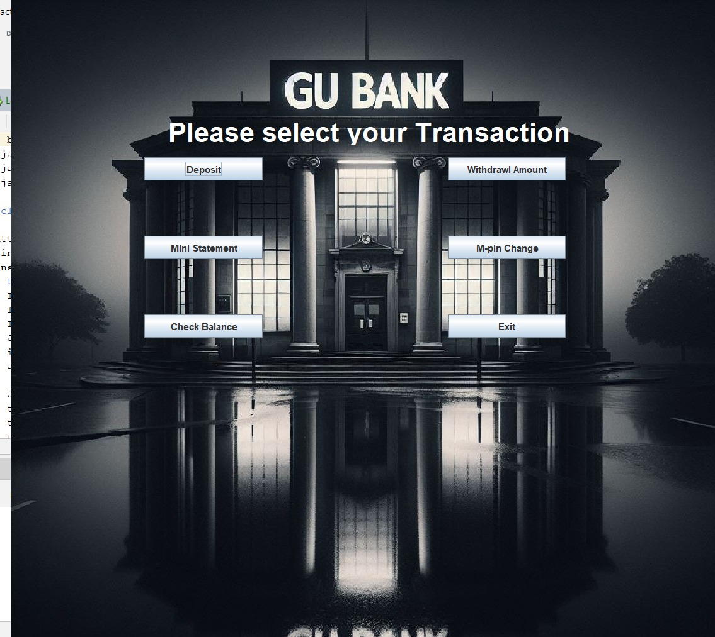
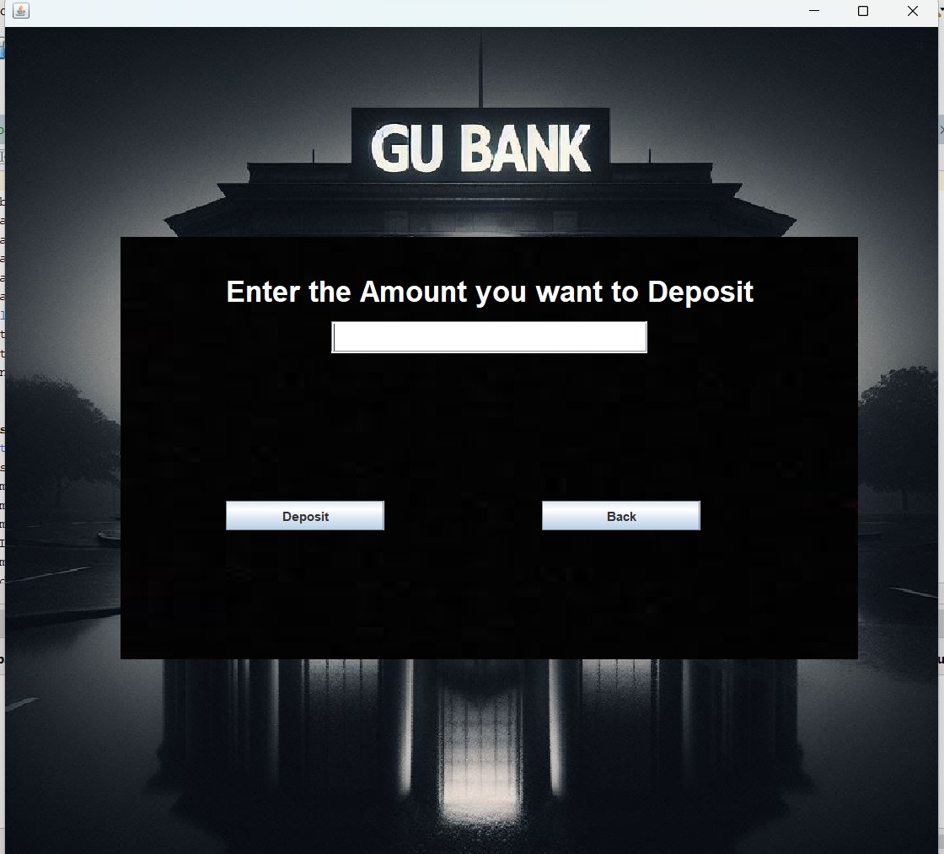
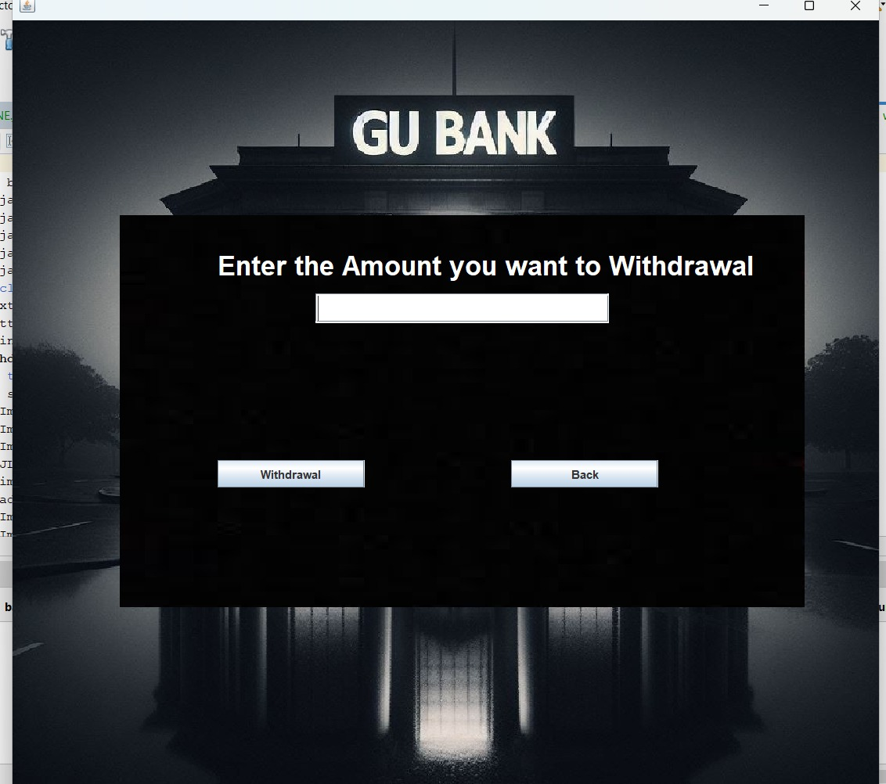
Output Screenshot
After Login Transaction Page
Deposit Page:
Withdrawal Page:
Select Deposit
Select Withdrawal
Enter Amount you want to Deposit & Withdrawal

Slide 12
References
www.youtube.com
Learning MySQL, Java
(University Classes & Youtube)
3. www.github.com
4. www.mdn.com

Slide 13


